Slide 1


ATTENTION AI
PROJECT
PResented By:
Student Name: Sarna Karandeep Singh
En. No: 202126940109
Semester: 10th
GUIDED BY:
Prof. Swati Solanki
Assistant Professor, Department of Mobile Application and Technologies / Designation of Mentor and Name of Company
M. Sc. IT Data Management & Visual Insight (5 Years Integrated)
Centre for Professional Courses, Gujarat University, Ahmedabad

Slide 2
Outline
Abstract
Introduction
Background Theory
Application of Technology
Literature Survey
Comparative Study
Motivation and Problem Statement
Research Objectives
Proposed Methodology
Conclusion
References

Slide 3
Abstract
System detects user attention using camera
Uses computer vision and AI techniques
Tracks face, eyes, and head movement
Gives real-time feedback through GUI
Useful in learning, exams, productivity

Slide 4
Introduction
Attention is important in learning and work
Manual monitoring is not accurate
AI can automate attention detection
Uses webcam and real-time processing
Provides continuous monitoring

Slide 5
Background Theory
Computer Vision: understanding images
Face Detection: locating face in frame
Landmark Detection: eyes, nose, mouth points
Eye Tracking: checking gaze direction
Machine Learning basics Pre Trained Model
Deep Learning for vision tasks
Real-time processing concept
Human attention behavior basics

Slide 6
Application OF Technology
Online classes monitoring
Exam proctoring systems
Workplace productivity tracking
Driver drowsiness detection
Smart learning environments

Slide 7
Literature Survey -1
Paper 1
Research Paper Name: “Automatic Recognition of Student Engagement using Deep Learning”
Author: Abhinav Dhall et al.
Publication: IEEE International Conference on Automatic Face & Gesture Recognition
Summary:
  This paper focuses on detecting student engagement using facial expressions and head movements
  Uses deep learning models to classify engagement levels such as attentive, bored, or distracted
  Works on video-based datasets collected in classroom environments
  Shows that combining facial features and temporal data improves accuracy
  Relevant because your project also analyzes facial behavior for attention detection

Slide 8
Literature Survey -2
Paper 2
Research Paper Name: “Facial Expression Recognition in Affective Computing”
Author: Maja Pantic
Publication: IEEE Transactions on Pattern Analysis and Machine Intelligence
Summary:
  Focuses on recognizing human emotions using facial expressions
  Uses facial landmark detection and machine learning techniques
  Explains how emotions like interest or boredom can be derived from facial cues
  Provides a strong theoretical base for attention-related systems
  Useful because attention detection is closely linked with emotional state

Slide 9
Literature Survey -3
Paper 3
Research Paper Name: “A Flexible New Technique for Camera Calibration”
Author: Zhengyou Zhang
Publication: IEEE Transactions on Pattern Analysis and Machine Intelligence
Summary:
  Introduces methods for estimating head pose and camera position
  Helps in determining face orientation and viewing angle
  Widely used in computer vision applications for pose estimation
  Essential for detecting whether a person is looking at the screen or not
  Your project uses similar concepts for head position tracking

Slide 10
Literature Survey -4
Paper 4
Research Paper Name: “Deep Residual Learning for Image Recognition (ResNet)”
Author: Kaiming He et al.
Publication: IEEE Conference on Computer Vision and Pattern Recognition (CVPR)
Summary:
  Introduces deep neural networks with residual connections
  Solves vanishing gradient problem in deep learning
  Achieves very high accuracy in image classification tasks
  Forms the base for many modern computer vision systems
  Relevant as it improves feature extraction in AI-based detection systems

Slide 11
Literature Survey -5
Paper 5
Research Paper Name: “Generative Adversarial Networks (GANs)”
Author: Ian Goodfellow
Publication: Neural Information Processing Systems (NeurIPS)
Summary:
  Introduces GANs for generating realistic images
  Uses two networks: generator and discriminator
  Improves data generation and model training techniques
  Widely used in advanced AI and computer vision tasks
  Though not directly used, it contributes to overall AI advancement used in such systems

Slide 12
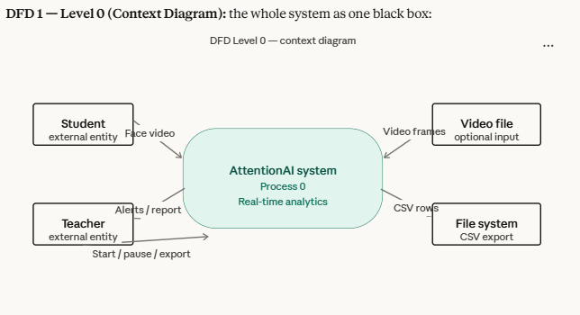

Slide 13
Comparative Study
Existing systems use only face detection
Some use only eye tracking
Few combine multiple features
Your system uses combined approach
Provides better accuracy

Slide 14
Motivation
Students lose focus in online classes
Teachers cannot track everyone
Need automated monitoring
Improves learning outcomes
Saves manual effort

Slide 15
Problem Statement
Students lose attention during online classes
Teachers cannot track every student continuously
Existing systems are limited or not real-time
There is no simple AI-based solution for attention monitoring
Need a system that detects attention using webcam in real-time

Slide 16
Research Objectives
Build real-time attention detection system
Use AI + Computer Vision
Develop GUI-based application
Achieve good accuracy
Make system user-friendly

Slide 17
Proposed System
Webcam captures video
Face and eyes detected
Head pose analyzed
Attention score calculated
Output shown in GUI

Slide 18
Technologies
Python
OpenCV
MediaPipe
Tkinter (GUI)
NumPy

Slide 19
Methodology
Capture video from webcam
Detect face using MediaPipe
Extract facial landmarks
Track eyes and head
Calculate attention score
Classify attentive/not attentive
Display result in GUI
Repeat continuously

Slide 20
Dataset
No external dataset used
Real-time webcam input
Works on live human data
Can be extended with datasets
Example: student sitting in front of camera

Slide 21
Implementation Details
Python script execution
Libraries installed via pip
Virtual environment used
Integrated with GUI
Runs on local system

Slide 22
Advantages
Real-time monitoring
Easy to use
No external hardware needed
Useful in education
Cost-effective

Slide 23
Limitations
Lighting affects accuracy
Camera quality matters
Cannot detect internal focus
Works best for single user
Limited advanced AI
Can’t Detect Fake Video

Slide 24
Real-World Applications
Online education platforms
Exam monitoring systems
Workplace productivity tools
Driver safety systems
AI-based learning tools

Slide 25
Future Scope
Add deep learning models
Improve accuracy
Multi-user detection
Mobile app version
Cloud integration

Slide 26
Screenshots / Gui Running

Slide 27
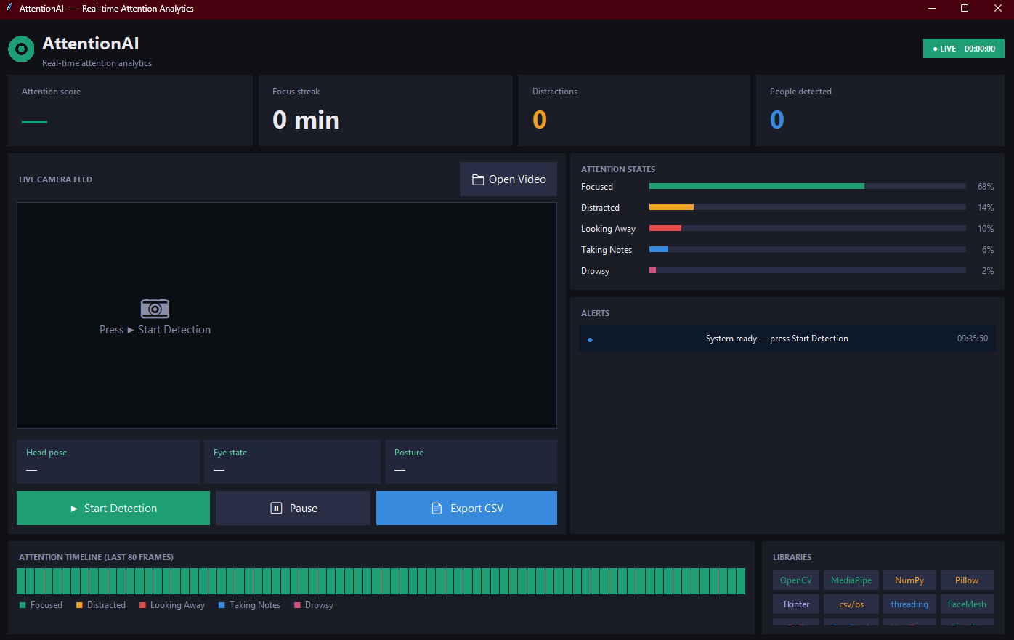

Slide 28


Slide 29

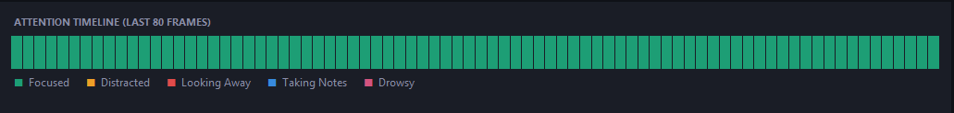

Slide 30
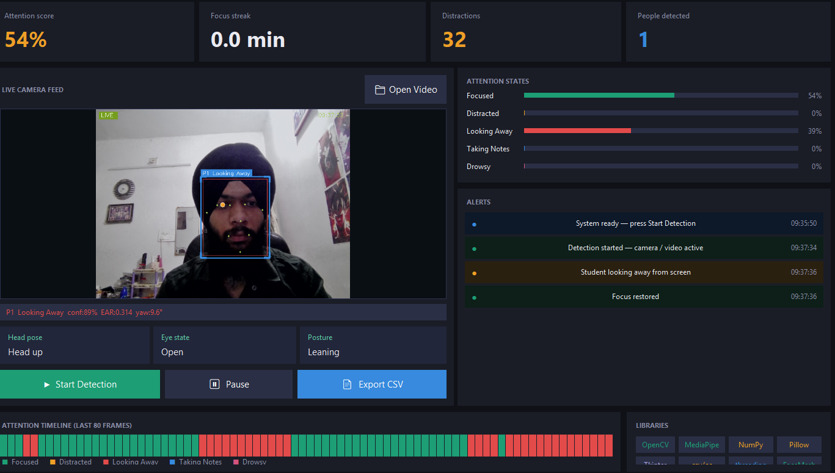

Slide 31
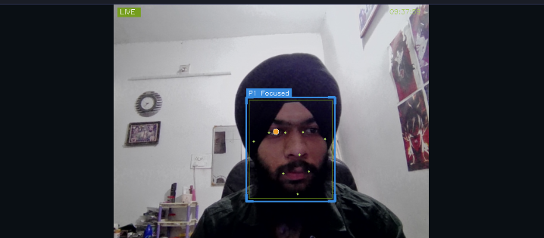

Slide 32
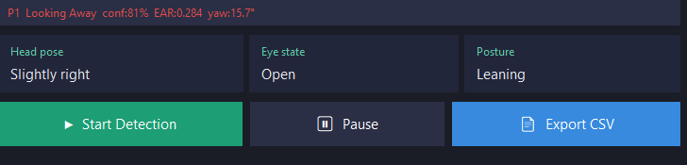
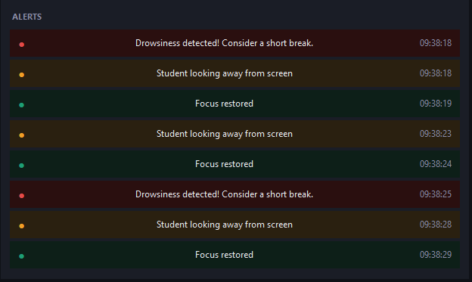
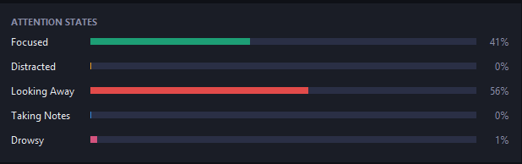

Slide 33
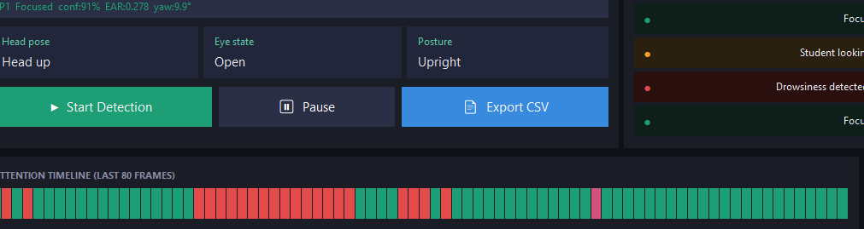

Slide 35
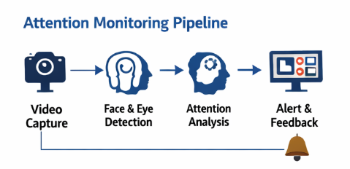
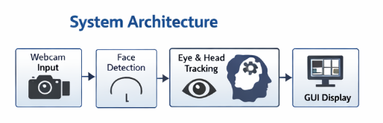
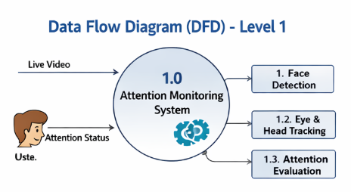

Slide 36
References
IEEE Papers
Research journals
OpenCV documentation
MediaPipe documentation
Python official docs

Slide 37
Thank You

